Slide 1
Paper Reading Summary
2020-02-17
Complementary-View Multiple Human Tracking
Pose-Assisted Multi-Camera Collaboration for Active Object Tracking
GlobalTrack: A Simple and Strong Baseline for Long-term Tracking
2020-02-24
Multi-camera vehicle tracking and re-identification based on visual and spatial-temporal features.
Single-camera and inter-camera vehicle tracking and 3d speed estimation based on fusion of visual and semantic features
A Simple Framework for Contrastive Learning of Visual Representations

Slide 2
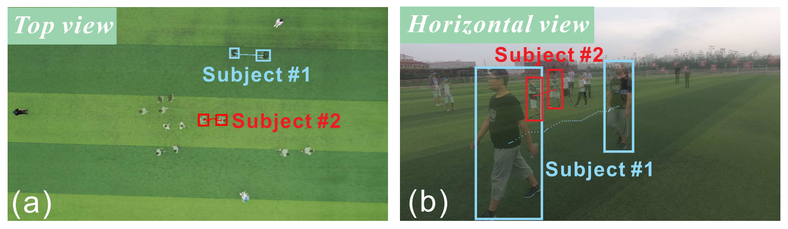
Complementary-View Multiple Human Tracking

Slide 3
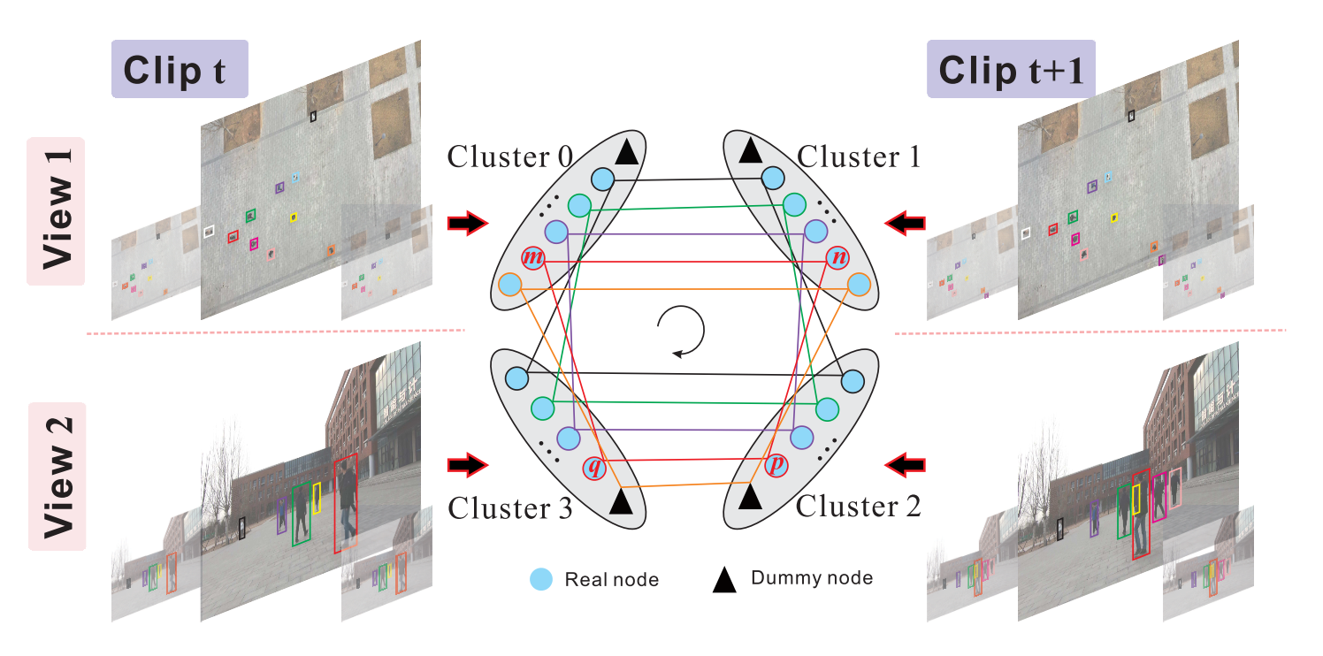
Complementary-View Multiple Human Tracking

Slide 4
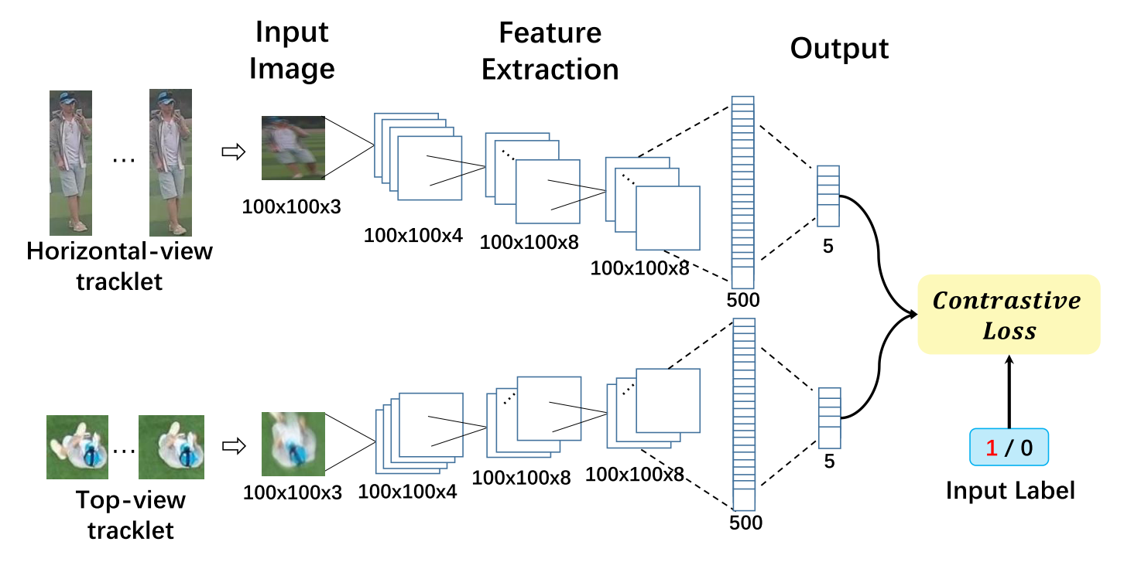
Complementary-View Multiple Human Tracking

Slide 5
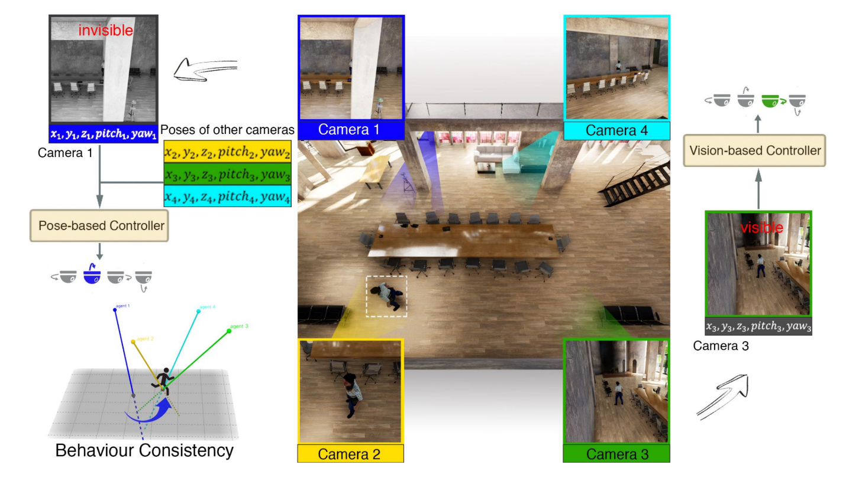
Pose-Assisted Multi-Camera Collaboration for Active Object Tracking

Slide 6
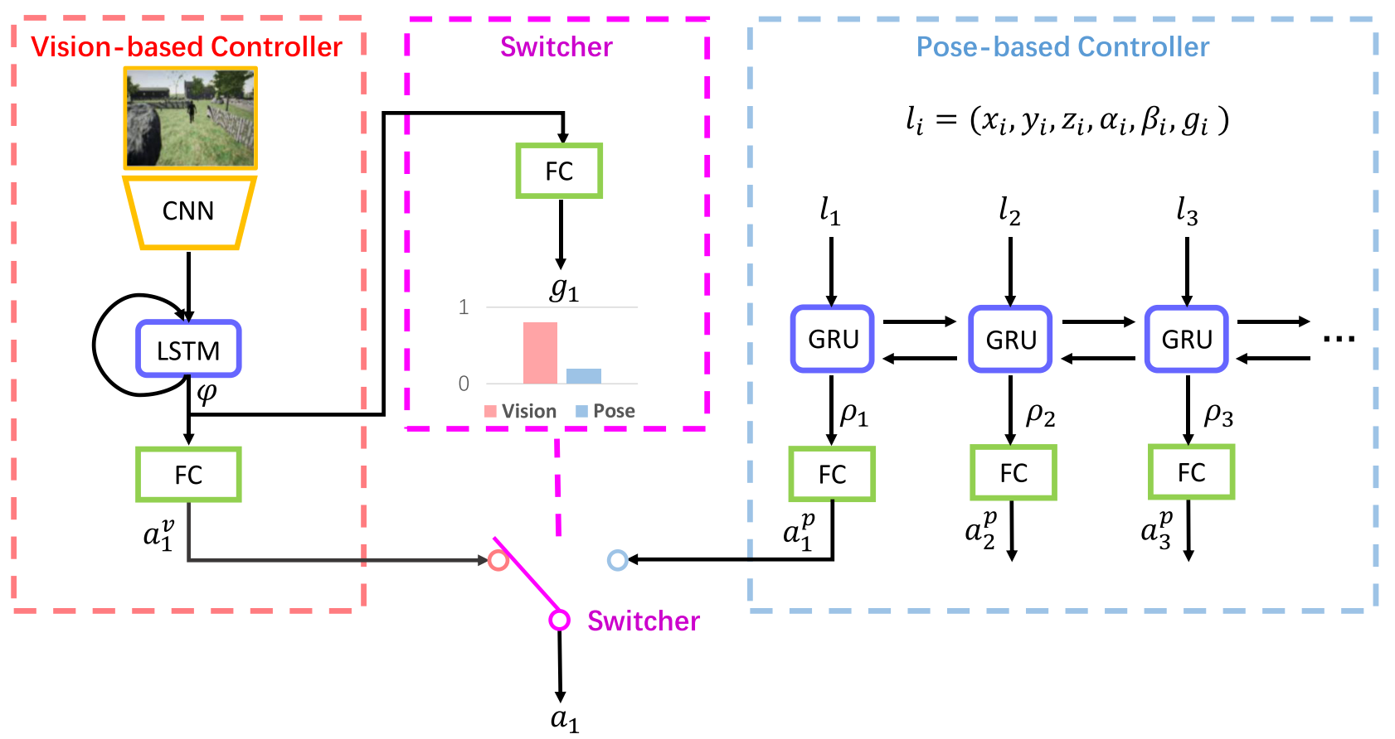
Pose-Assisted Multi-Camera Collaboration for Active Object Tracking

Slide 7
Multi-camera vehicle tracking and re-identification based on visual and spatial-temporal features
1）利用detector检测出画面中所有的车辆，这与MOT的tracking-by-detection方法是一致的。
2）使用单摄像头多目标跟踪的方法，先进行一次数据关联，获得tracklet。
3）使用Re-ID模型提取每一个tracklet的visual feature。Re-ID模型也是本文介绍的一个重点，这篇文章的Re-ID模型获得了workshop中Re-ID题目的第一名。
4）最后使用多摄像头跟踪的方法，对不同摄像头下的tracklet进行关联，得到最终的结果。

Slide 8
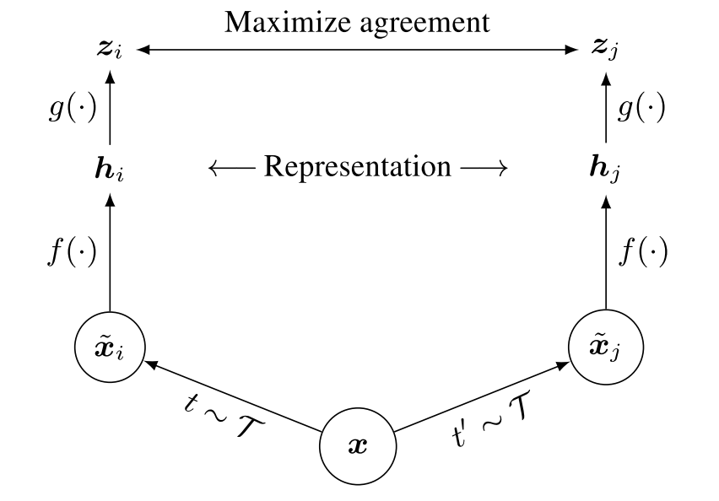
A Simple Framework for Contrastive Learning of Visual Representations

